Slide 1
The Legend
of
the Wawel Dragon
by FRED

Slide 2
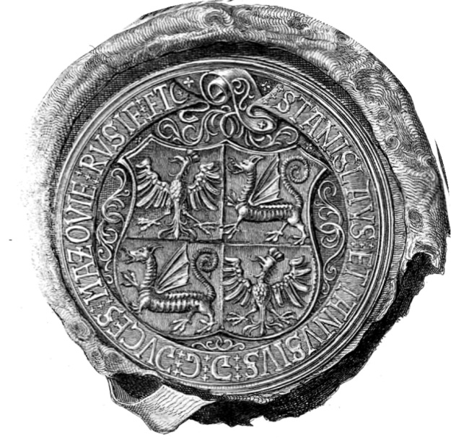
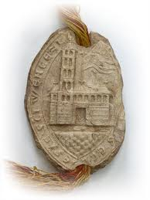
Some centuries ago there was a terrible dragon which lived in a cave under the Wawel Hill. The bravest knights tried to solve the problem but they couldn’t.
The king who reigned at the time sent out his heralds to announce that who could slay the dragon would as a reward marry his daughter and sit on his throne after his death.
A shoemaker named Krak decided to conquer the beast by an unique strategy. He stuffed sheep’s skin with sulphur, and he place it at the cave's entrance. The dragon, being greedy as well as stupid, swallowed the gift in one mouthful. Its throat burned so much that it ran to the Vistula river, gulping down so much water that it burst with a great bang.
The shoemaker married the king's daughter, and after the monarch's death, ascended to the throne. The town he rescued from the clutches of the dragon, took its name from him, and bears it to this day with great honour - the old capital of Poland, Krakow.

Slide 3
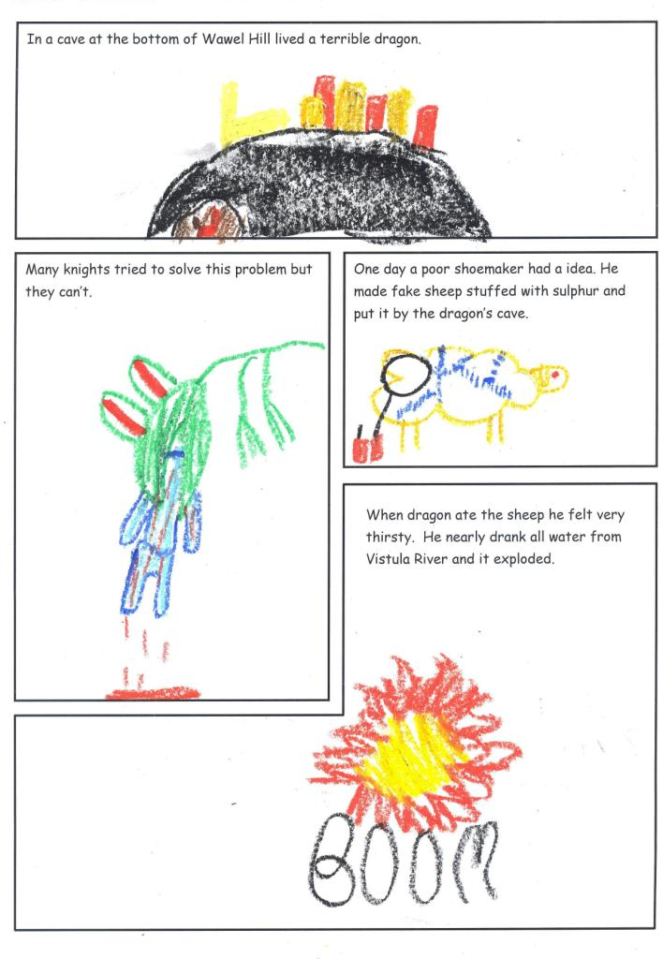
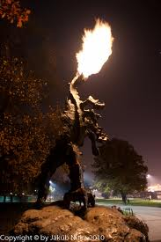
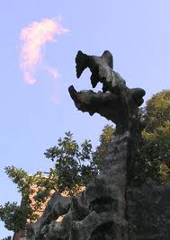
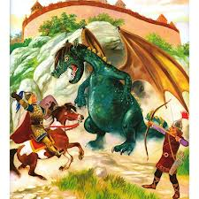
The Legend
of
the Wawel Dragon

Slide 4
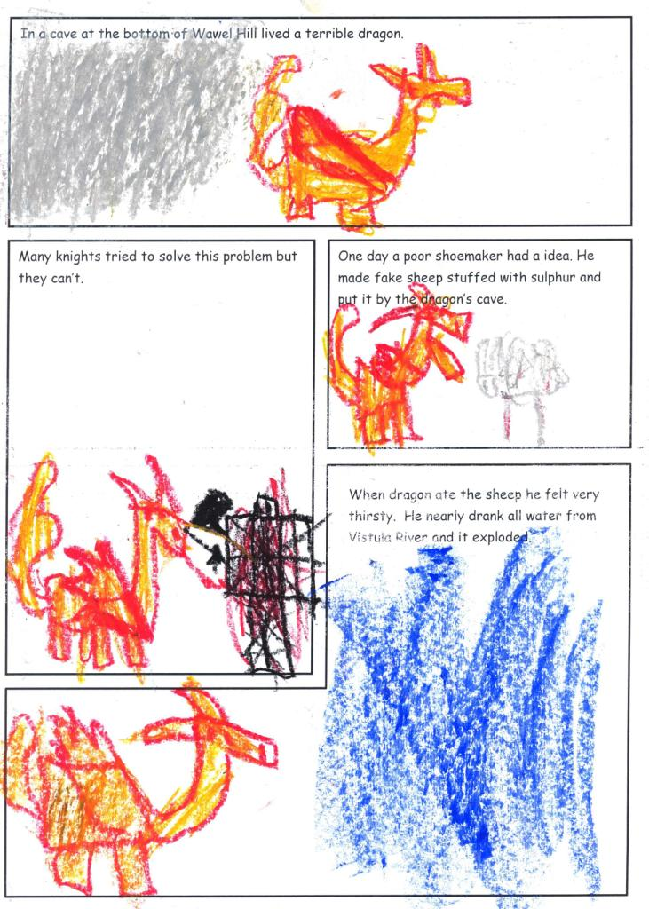
The Legend
of
the Wawel Dragon

Slide 5
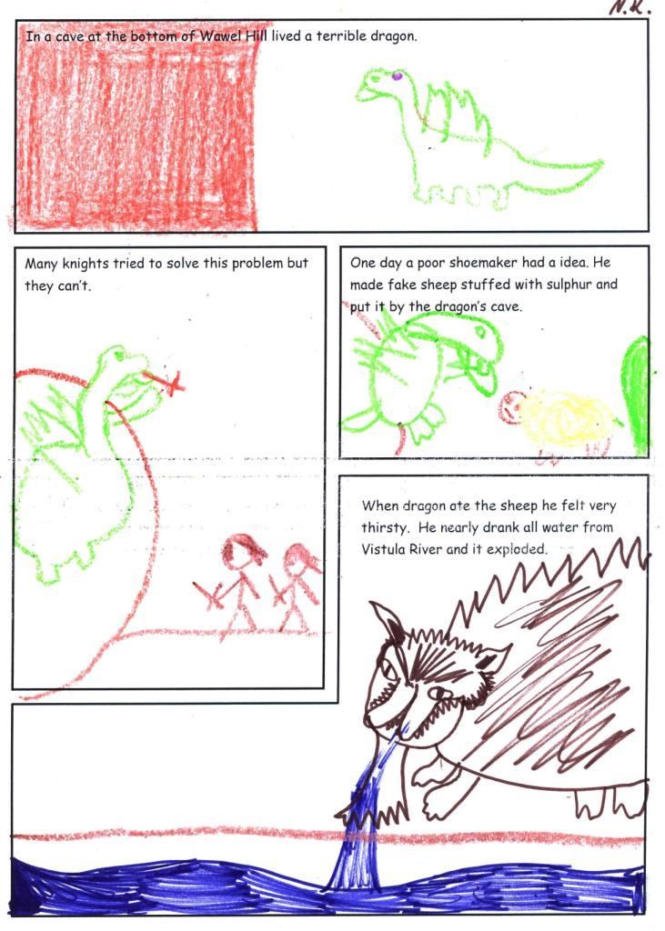
The Legend
of
the Wawel Dragon

Slide 6
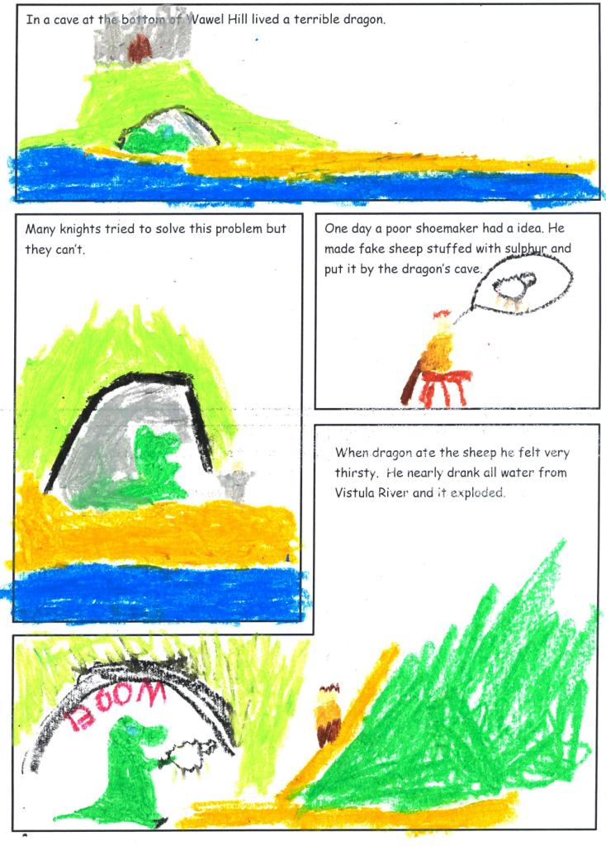
The Legend
of
the Wawel Dragon

Slide 7
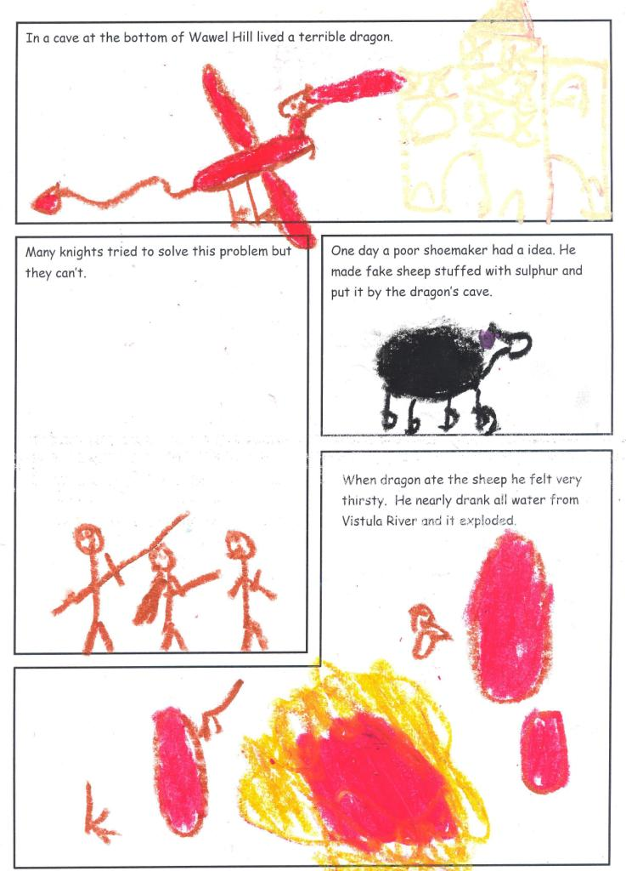
The Legend
of
the Wawel Dragon

Slide 8
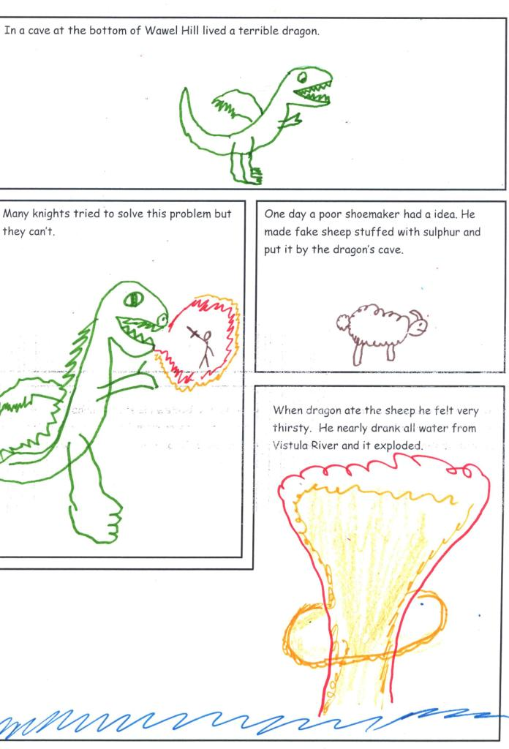
The Legend
of
the Wawel Dragon

Slide 9
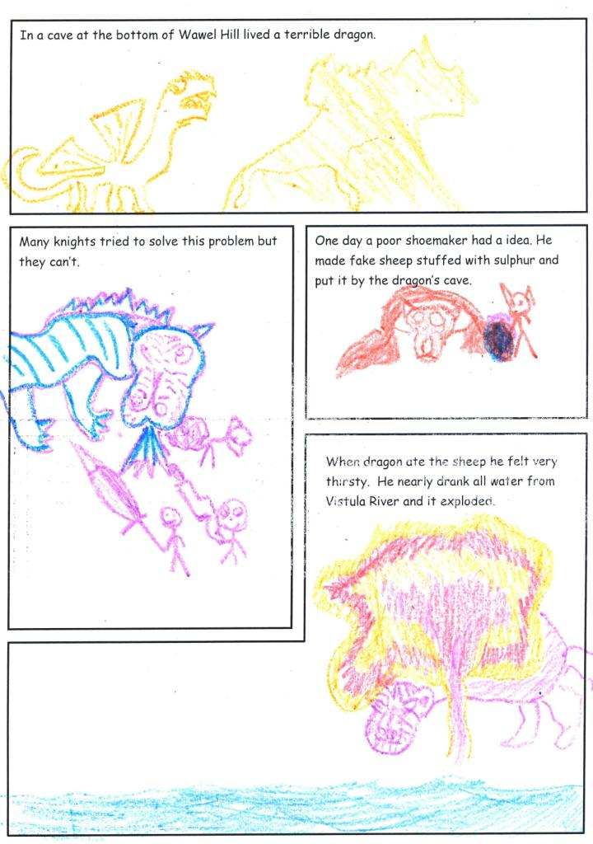
The Legend
of
the Wawel Dragon

Slide 10
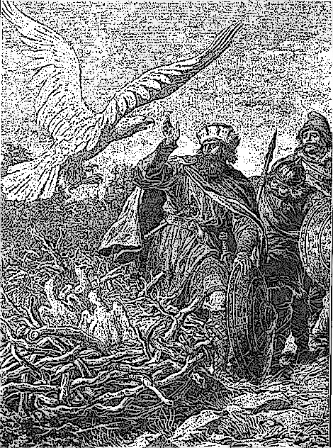
The Legend Of The Three Brothers
LECH, CZECH i RUS

Slide 11
Over one thousand years ago, there lived a king who
ruled over the lands by Vistula river. When the king died, his wealth was left to his three sons: Lech, Czech and Rus. The kingdom was small so they decided to leave in search of other lands.
Lech, Czech and Rus decided to go in different directions. Czech travelled to the south and Rus went to the east. Lech travelled to the North until he came across a giant oak tree. Within the oak tree was a giant white eagle guarding
its nest, Lech took this as a good omen and decided
to begin his settlement on the same spot and this
place went on to be called Gniezno the first
capital of Poland.

Slide 12
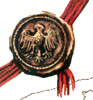
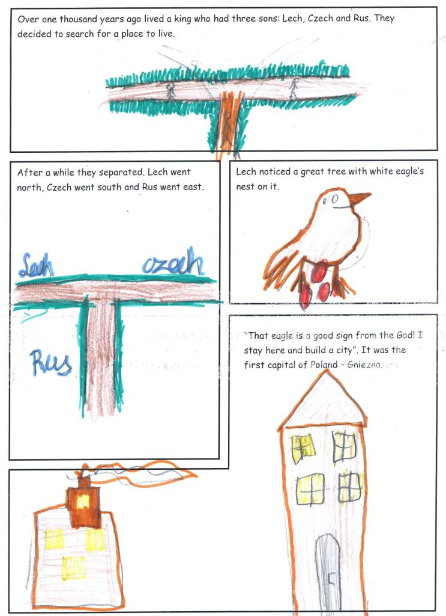
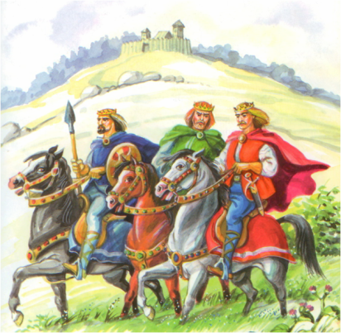
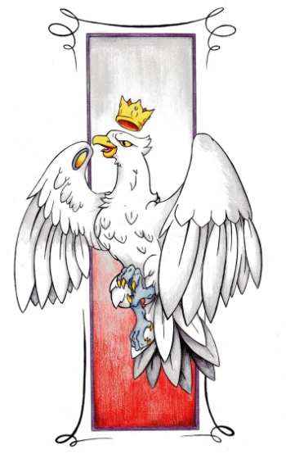
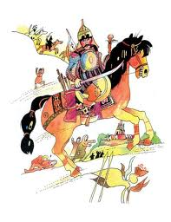
LECH, CZECH i RUS

Slide 13
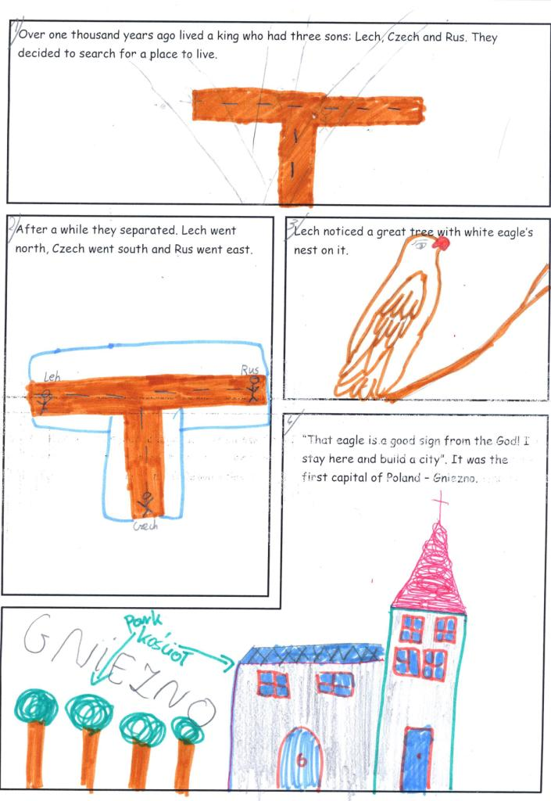
LECH, CZECH i RUS

Slide 14
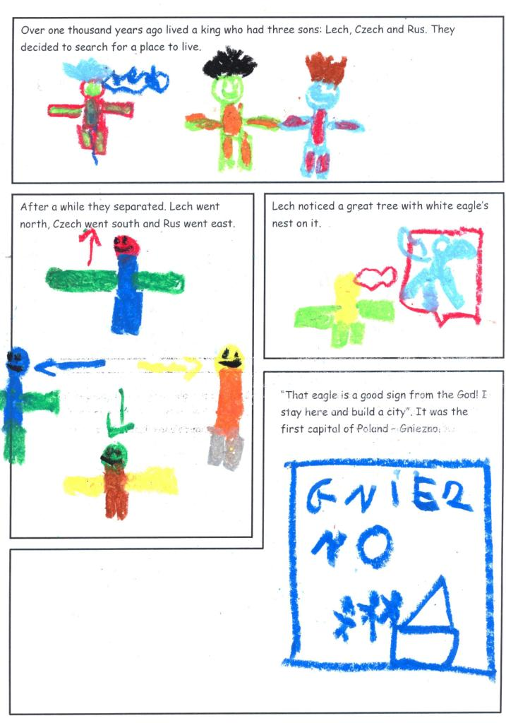
LECH, CZECH i RUS

Slide 15
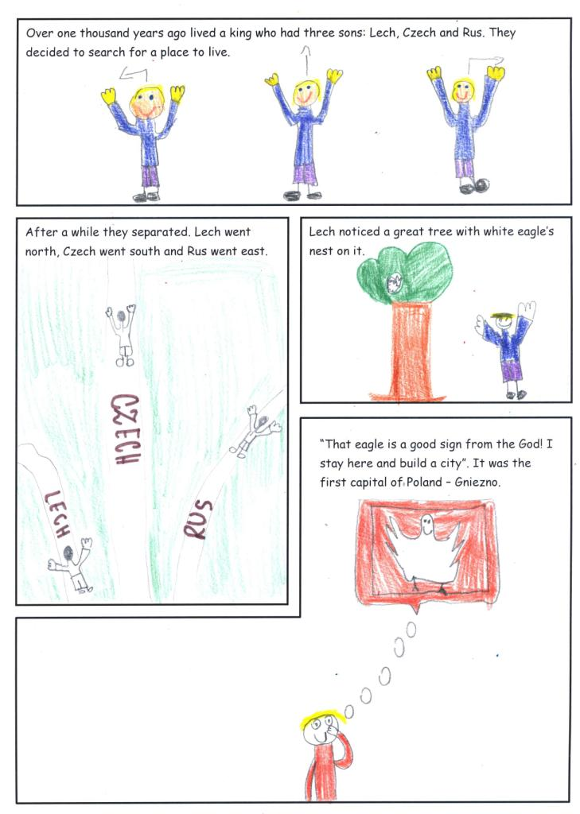
LECH, CZECH i RUS

Slide 16
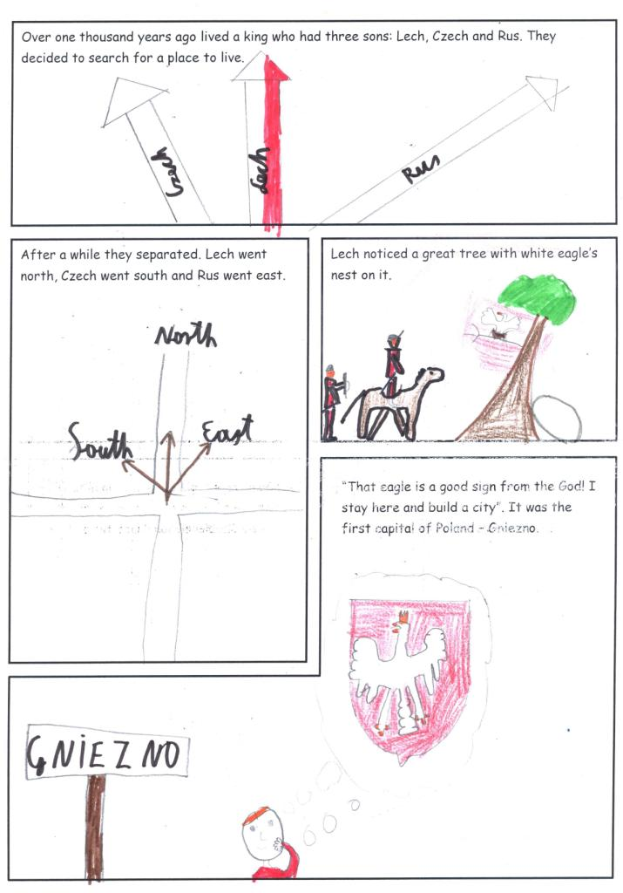
LECH, CZECH i RUS

Slide 17
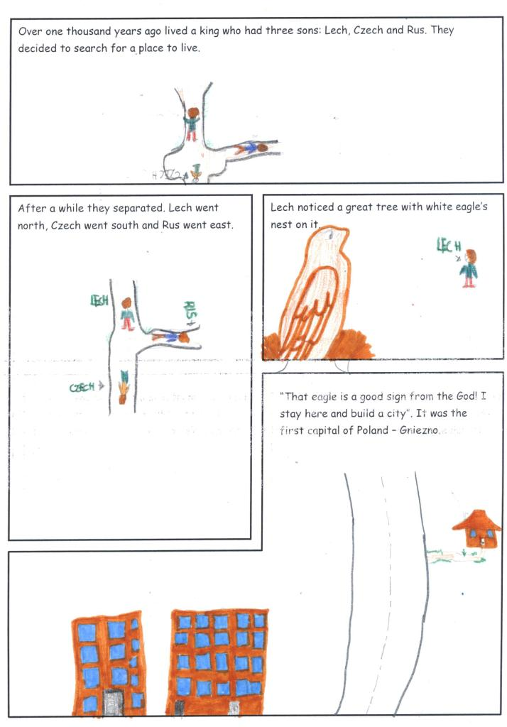
LECH, CZECH i RUS

Slide 18
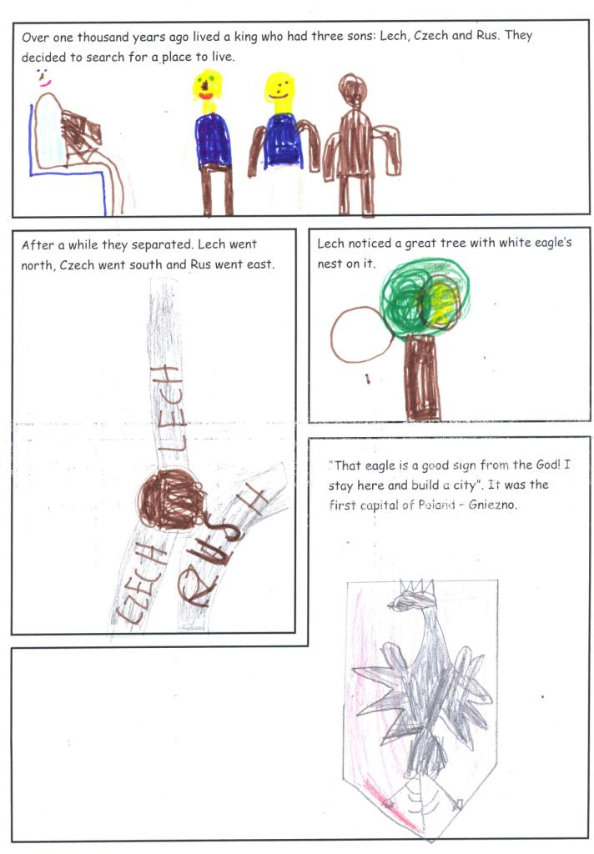
LECH, CZECH i RUS

Slide 19
THANK YOU!

